Slide 1
Technology for Success: Computer Concepts

Slide 2
Databases
Module 13

Slide 3
Lesson Objectives
Discuss the importance of databases
Use a database management system
Discuss how data informs business decision-making
Campbell/Ciampa/Clemens/Freund/Frydenberg/Hooper/Ruffolo/West, Technology for Success: Computer Concepts, 1st Edition. © 2020 Cengage. All Rights Reserved. May not be scanned, copied or duplicated, or posted to a publicly accessible website, in whole or in part.

Slide 4
Discuss the Importance of Databases (1 of 2)
Compare spreadsheets and databases
Define relational databases
Campbell/Ciampa/Clemens/Freund/Frydenberg/Hooper/Ruffolo/West, Technology for Success: Computer Concepts, 1st Edition. © 2020 Cengage. All Rights Reserved. May not be scanned, copied or duplicated, or posted to a publicly accessible website, in whole or in part.

Slide 5
Discuss the Importance of Databases (2 of 2)
Database: collection of data organized in a way that allows you to access, retrieve, and create reports of that data
Lifeblood of most organizations; entrusted with the critical job of organizing data, making it easily accessible when needed, and ensuring it is kept safe and secure
Documents and spreadsheets store information; generally isolated from information held in other documents or spreadsheets
Databases show connections between different sets of data
Campbell/Ciampa/Clemens/Freund/Frydenberg/Hooper/Ruffolo/West, Technology for Success: Computer Concepts, 1st Edition. © 2020 Cengage. All Rights Reserved. May not be scanned, copied or duplicated, or posted to a publicly accessible website, in whole or in part.

Slide 6
Compare Spreadsheets and Databases
Spreadsheets store numbers, charts, and other data in a grid of cells where they can perform automatic recalculations as data changes
Data is laid out in a grid of rows and columns
Database advantages
Show relationships between tables: tables store data in a grid format and relationships show how data in one table relates to data in another table
Efficient data updates
Data validation with new additions
Easily handles large amounts of data
Allows real-time user access and tracking
Campbell/Ciampa/Clemens/Freund/Frydenberg/Hooper/Ruffolo/West, Technology for Success: Computer Concepts, 1st Edition. © 2020 Cengage. All Rights Reserved. May not be scanned, copied or duplicated, or posted to a publicly accessible website, in whole or in part.

Slide 7
Define Relational Databases
Relational databases rely on relationships between types of data to show how some data is related to other data
Best suited to data that can be organized into tables where each record in a table stores the same pieces of information
Most relational databases are managed using Structured Query Language (SQL)
Programming language used to configure and interact with the database’s objects and data
Campbell/Ciampa/Clemens/Freund/Frydenberg/Hooper/Ruffolo/West, Technology for Success: Computer Concepts, 1st Edition. © 2020 Cengage. All Rights Reserved. May not be scanned, copied or duplicated, or posted to a publicly accessible website, in whole or in part.

Slide 8
Use a Database Management System (1 of 2)
Identify popular database management systems
Compare front-end and back-end database components
Organize data in a database
Interact with data
Use Structured Query Language (SQL)
Secure a database
Back up and recover a database
Campbell/Ciampa/Clemens/Freund/Frydenberg/Hooper/Ruffolo/West, Technology for Success: Computer Concepts, 1st Edition. © 2020 Cengage. All Rights Reserved. May not be scanned, copied or duplicated, or posted to a publicly accessible website, in whole or in part.

Slide 9
Use a Database Management System (2 of 2)
The database itself contains the data records and fields
You access data in the database through a database management system (DBMS)
Database management system (DBMS): collection of programs used to interact with and manage data in the database
Campbell/Ciampa/Clemens/Freund/Frydenberg/Hooper/Ruffolo/West, Technology for Success: Computer Concepts, 1st Edition. © 2020 Cengage. All Rights Reserved. May not be scanned, copied or duplicated, or posted to a publicly accessible website, in whole or in part.

Slide 10
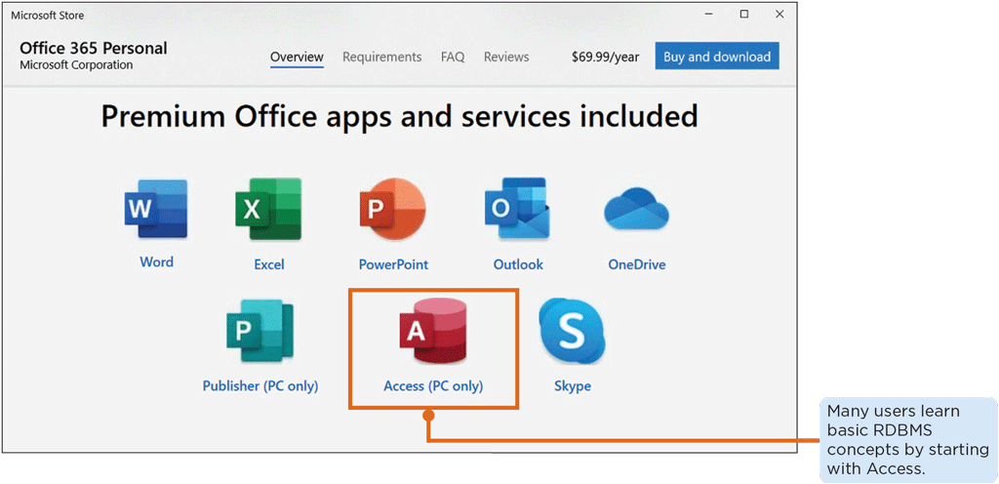
Identify Popular Database Management Systems
Relational database management systems (RDBMSs)
Microsoft Access
Oracle
MySQL
Microsoft SQL Server
Maria DB
PostgreSQL
Amazon’s Aurora
Figure 13-3: Access is one application in the Microsoft Office suite of applications
Campbell/Ciampa/Clemens/Freund/Frydenberg/Hooper/Ruffolo/West, Technology for Success: Computer Concepts, 1st Edition. © 2020 Cengage. All Rights Reserved. May not be scanned, copied or duplicated, or posted to a publicly accessible website, in whole or in part.

Slide 11
Compare Front-end and Back-end Database Components
Front-end database
Built using web languages such as HTML, CSS, and JavaScript
Designed to be user friendly while limiting and streamlining the kinds of tasks a user can complete within the database
Back-end database
Includes the database server hosting the data, some aspects of the DBMS, and the database itself
Specially trained database administrators (DBAs) work with the back-end components to ensure a company’s business data is safe, secure, and well-managed
Campbell/Ciampa/Clemens/Freund/Frydenberg/Hooper/Ruffolo/West, Technology for Success: Computer Concepts, 1st Edition. © 2020 Cengage. All Rights Reserved. May not be scanned, copied or duplicated, or posted to a publicly accessible website, in whole or in part.

Slide 12
Organize Data in a Database (1 of 2)
Data in a database is organized to allow for quick searches and to support connections between data in relationships
Tables: stores data in a relational database
Data validation: ensures data entered into a database makes sense and meets certain criteria
Primary keys: numeric fields that contain a unique number
Indexes: data structures in the database that speed up searching and sorting records in a table
Relationships: connect data in one table with data in another table
One-to-many, one-to-one, and many-to-many relationships
Campbell/Ciampa/Clemens/Freund/Frydenberg/Hooper/Ruffolo/West, Technology for Success: Computer Concepts, 1st Edition. © 2020 Cengage. All Rights Reserved. May not be scanned, copied or duplicated, or posted to a publicly accessible website, in whole or in part.

Slide 13
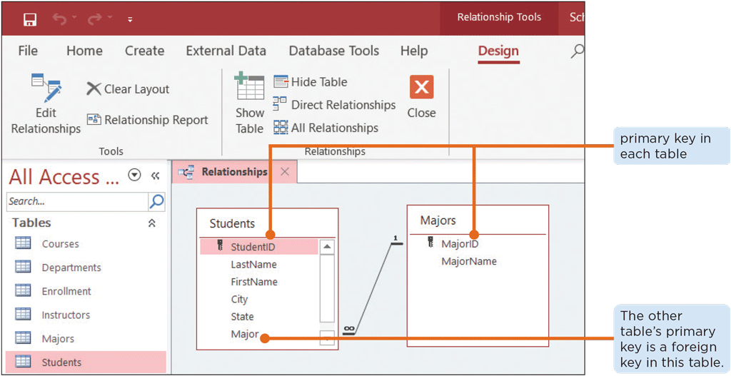
Organize Data in a Database (2 of 2)
Figure 13-13: In a relationship, one table’s primary key becomes a foreign key in the other table
Campbell/Ciampa/Clemens/Freund/Frydenberg/Hooper/Ruffolo/West, Technology for Success: Computer Concepts, 1st Edition. © 2020 Cengage. All Rights Reserved. May not be scanned, copied or duplicated, or posted to a publicly accessible website, in whole or in part.

Slide 14
Interact with Data
Data in a database is only useful if you can put it to work
Add and delete data
Forms: designed for easily entering data into a table
Sort and filter data
Queries: combine data from one or more tables
Analyze the data to detect patterns
Reports: output data in a visually appealing format
Campbell/Ciampa/Clemens/Freund/Frydenberg/Hooper/Ruffolo/West, Technology for Success: Computer Concepts, 1st Edition. © 2020 Cengage. All Rights Reserved. May not be scanned, copied or duplicated, or posted to a publicly accessible website, in whole or in part.

Slide 15
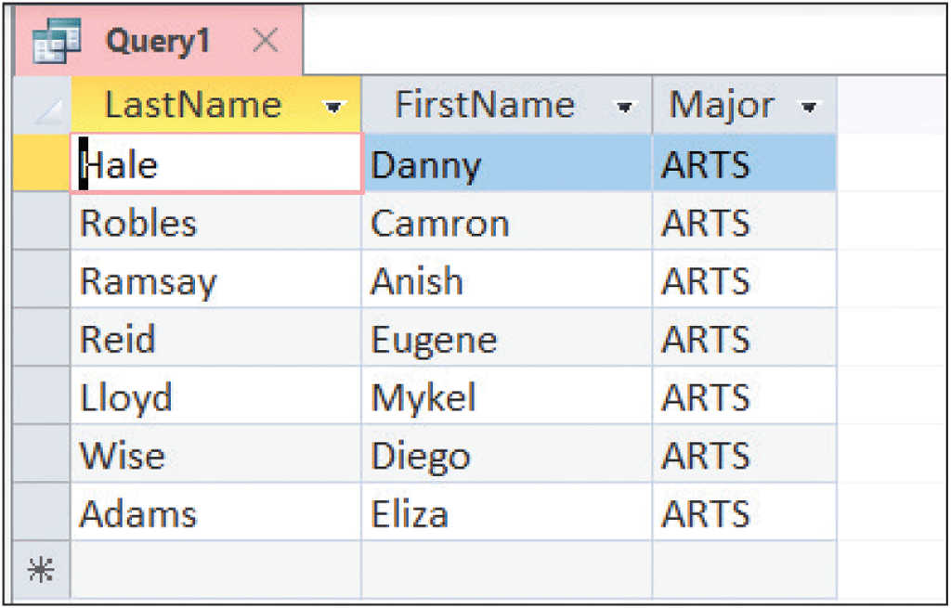
Use Structured Query Language (SQL)
Common SQL operations
SELECT
DELETE
INSERT
UPDATE
Figure 13-25: This query shows the names of all students with an Arts major
Campbell/Ciampa/Clemens/Freund/Frydenberg/Hooper/Ruffolo/West, Technology for Success: Computer Concepts, 1st Edition. © 2020 Cengage. All Rights Reserved. May not be scanned, copied or duplicated, or posted to a publicly accessible website, in whole or in part.

Slide 16
Secure a Database
Best practices in database security
Users given access to the database should be required to use long, secure passwords for their accounts
Database servers should reside in more secure segments of the network behind a firewall
Sensitive data in a database should be encrypted
Campbell/Ciampa/Clemens/Freund/Frydenberg/Hooper/Ruffolo/West, Technology for Success: Computer Concepts, 1st Edition. © 2020 Cengage. All Rights Reserved. May not be scanned, copied or duplicated, or posted to a publicly accessible website, in whole or in part.

Slide 17
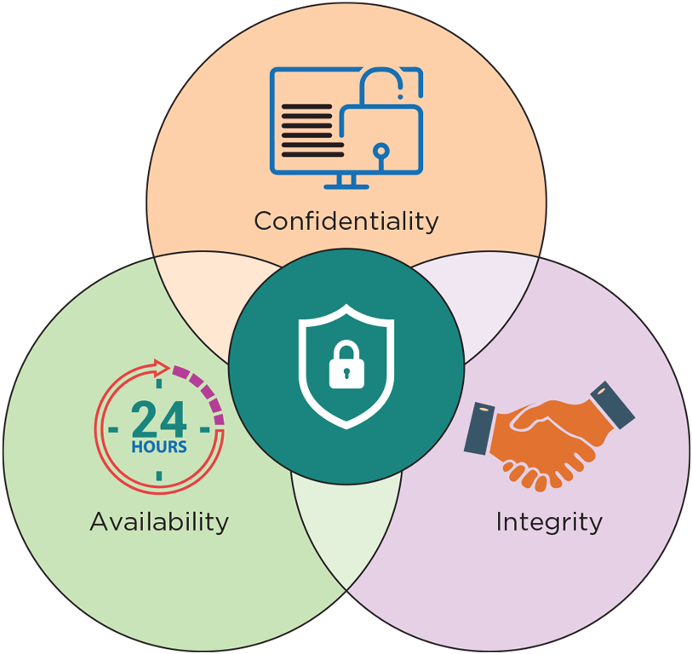
Back Up and Recover a Database
Ensuring that data is accessible when it’s needed and that no one has made unauthorized changes are also key aspects of database security
Figure 13-27: The CIA triad is a classic security model for protecting data
Campbell/Ciampa/Clemens/Freund/Frydenberg/Hooper/Ruffolo/West, Technology for Success: Computer Concepts, 1st Edition. © 2020 Cengage. All Rights Reserved. May not be scanned, copied or duplicated, or posted to a publicly accessible website, in whole or in part.

Slide 18
Discuss How Data Informs Business Decisions (1 of 2)
Explain the significance of Big Data
Define nonrelational databases
Explore the impact of business intelligence
Campbell/Ciampa/Clemens/Freund/Frydenberg/Hooper/Ruffolo/West, Technology for Success: Computer Concepts, 1st Edition. © 2020 Cengage. All Rights Reserved. May not be scanned, copied or duplicated, or posted to a publicly accessible website, in whole or in part.

Slide 19
Discuss How Data Informs Business Decisions (2 of 2)
Raw and unorganized facts are not valuable to organizations
When data has been processed in a way that reveals patterns, relationships, and other insights, it becomes information
To get meaningful insights, a large volume of relevant data is required
Database technologies have evolved over the years to handle massive amounts of data
Campbell/Ciampa/Clemens/Freund/Frydenberg/Hooper/Ruffolo/West, Technology for Success: Computer Concepts, 1st Edition. © 2020 Cengage. All Rights Reserved. May not be scanned, copied or duplicated, or posted to a publicly accessible website, in whole or in part.

Slide 20
Explain the Significance of Big Data
Big Data: large and complex data sources that defy traditional data processing methods
Often described according to:
Volume: massive amount of data that must be stored and analyzed
Variety: different formats in which this data can exist
Velocity: data is often generated and received at high speeds
Value: helpfulness of the data in making strategic decisions
Veracity: how accurately data reflects reality
Campbell/Ciampa/Clemens/Freund/Frydenberg/Hooper/Ruffolo/West, Technology for Success: Computer Concepts, 1st Edition. © 2020 Cengage. All Rights Reserved. May not be scanned, copied or duplicated, or posted to a publicly accessible website, in whole or in part.

Slide 21
Define Nonrelational Databases
NoSQL databases or nonrelational databases resolve many of the weaknesses of relational databases
Use a variety of approaches to store many kinds of data
Key-value databases
Highly scalable: resources available to the database can be increased to handle the massive volume of Big Data that continues to increase indefinitely
High availability: data stored in a nonrelational database is more protected from loss due to a system or hardware failure
Campbell/Ciampa/Clemens/Freund/Frydenberg/Hooper/Ruffolo/West, Technology for Success: Computer Concepts, 1st Edition. © 2020 Cengage. All Rights Reserved. May not be scanned, copied or duplicated, or posted to a publicly accessible website, in whole or in part.

Slide 22
Explore the Impact of Business Intelligence
Business intelligence (BI): processes and technologies used for data analysis
Example: giving insights to improve business processes and increase productivity
BI systems might collect existing and live-streaming data into a central repository called a data warehouse
Another option is a data lake: a collection of structured and unstructured data
After data from a data warehouse or data lake is summarized and analyzed, it’s often presented to decision makers in dashboards
Provide at-a-glance views, with live updates as data continues to pour in
Emerging patterns and insights help to inform business decisions and strategies
Campbell/Ciampa/Clemens/Freund/Frydenberg/Hooper/Ruffolo/West, Technology for Success: Computer Concepts, 1st Edition. © 2020 Cengage. All Rights Reserved. May not be scanned, copied or duplicated, or posted to a publicly accessible website, in whole or in part.

